Slide 1

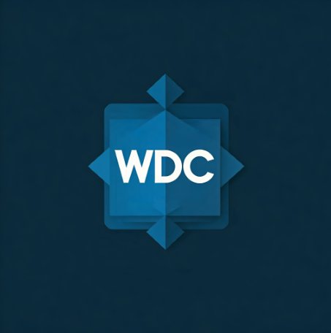
Basic Bootstrap

Slide 2

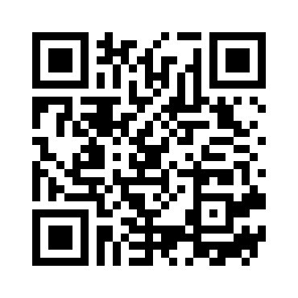
Please Scan it

Slide 3

What is Bootstrap?
Bootstrap is an open-source front-end framework developed by Twitter (now maintained by the community) that helps developers design responsive, mobile-first websites quickly and easily. It provides a collection of HTML, CSS, and JavaScript components, tools, and layouts to streamline web development.

Slide 4
Why use it?
Saves time, ensures consistency, and works on all devices.
Used by millions of websites (examples: Spotify, Lyft)

Slide 5
Responsive Grid system
12-column layout + breakpoints (xs, sm, md, lg, xl).
Divide the screen into 12 equal-width columns (like a spreadsheet).
Rows (<div class="row">) wrap columns (<div class="col-*">).

Slide 6

Visual Presentation
- p-0 to p-5
Format: p-{size} (padding)
What it does: Adds padding on ALL sides (top, right, bottom, left).
Size: 0 - 5 = 3rem (48px) of padding (Bootstrap's largest preset spacing).
- mb: 0 – 5:
Format: m{b}-{size} (margin-bottom)
What it does: Adds margin ONLY to the bottom.
Size: 5 = 3rem (48px) of margin.
- mt: 0 - 5
Format: m{t}-{size} (margin-top)
What it does: Adds margin ONLY to the top.
Size: 5 = 3rem (48px) of margin.

Slide 7

Source:
https://getbootstrap.com
Get the files to practice
Create an empty folder
Use your terminal to navigate and find that folder
Then type this: git clone https://github.com/BJcheng935/WDC_Bootstrap.git

Slide 8

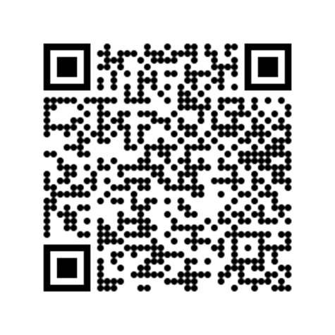
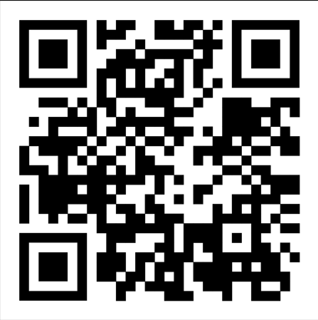
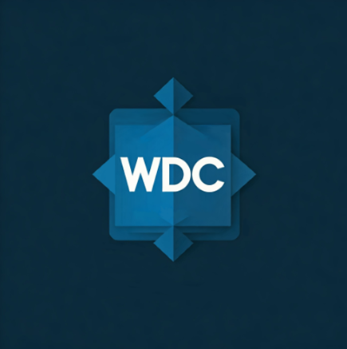
Discord
Mine Tracker
Attendance

